Slide 1
Parallel Processing, Multitasking, Virtualization, Distributed Systems, Cloud

Slide 2
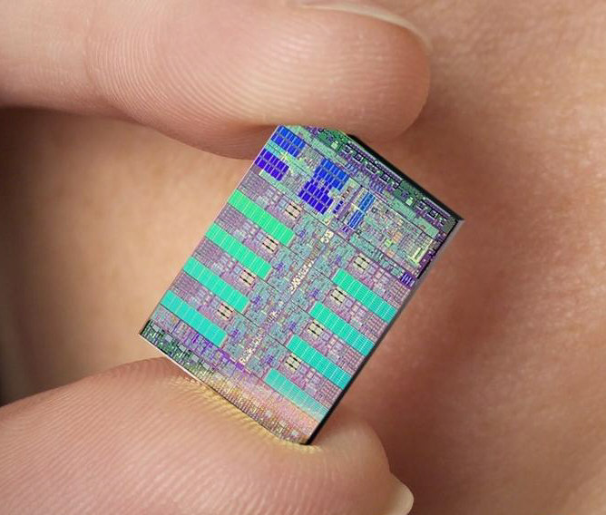
What is Parallel Processing?
How to make machines solve problems better and faster?
Physical barriers limit the extent to which single processor performance can be improved—Clock Speed & Heat Dissipation
The next most obvious solution is to distribute the computing load among several processors

Slide 3
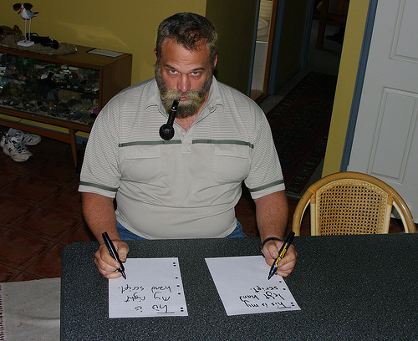
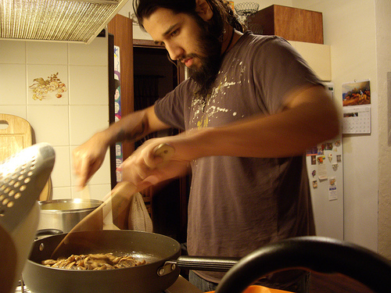

Parallel Processing in Nature
For humans parallel processing comes easy
Human Vision
Color, Motion, Depth, Shape

Slide 4
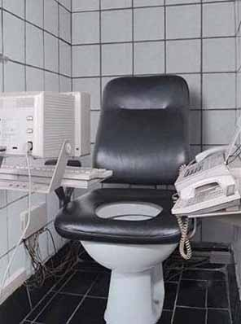
Parallel Processing vs. Multitasking
Today, computers are great at multi-tasking, but…
Multi-tasking only creates the illusion of parallel processing
The processor must switch between activities—it is only the speed with which it does so that creates the illusion of simultaneous execution

Slide 5



Parallel Processing vs. Multitasking
Think about it this way:
Multi-tasking
Parallel Processing

Slide 6
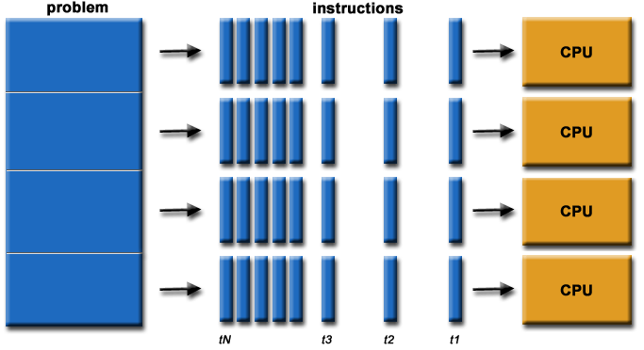
What is Parallel Computing?
Parallel computing is the simultaneous use of multiple compute resources to solve a computational problem.

Slide 7
Concepts
Distinguishes multi-processor architecture by instruction and data
SISD – Single Instruction, Single Data
SIMD – Single Instruction, Multiple Data
MISD – Multiple Instruction, Single Data
MIMD – Multiple Instruction, Multiple Data

Slide 8
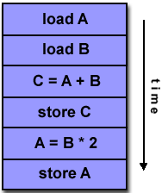
SISD: Single Instruction, Single Data
Serial
Only one instruction and data stream is acted on during any one clock cycle

Slide 9
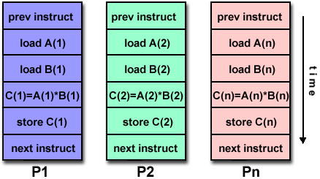
Single Instruction, Multiple Data
All processing units execute the same instruction at any given clock cycle.
Each processing unit operates on a different data element.

Slide 10
Multiple Instruction, Single Data
Different instructions operated on a single data element.
Example: Multiple cryptography algorithms attempting to crack a single coded message.

Slide 11
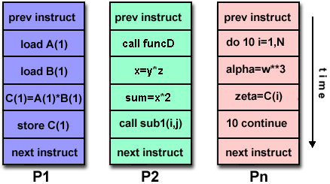
Multiple Instruction, Multiple Data
Can execute different instructions on different data elements.
Most common type of parallel computer.

Slide 12
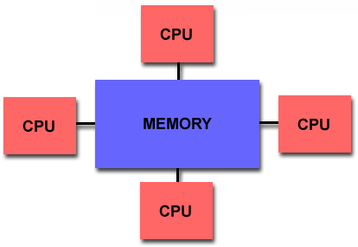
Parallel Computer Memory Architectures:
Shared Memory Architecture
All processors access all memory as a single global address space.
Data sharing is fast.
Lack of scalability between memory and CPUs

Slide 13
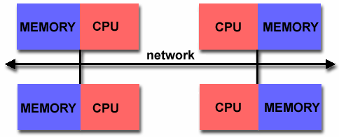
Parallel Computer Memory Architectures:
Distributed Memory
Each processor has its own memory.
Is scalable, no overhead for cache coherency.
Programmer is responsible for many details of communication between processors.

Slide 14
Parallel Programming Models
  Shared Memory Model
  Messaging Passing Model
  Data Parallel Model

Slide 15
Parallel Programming Models:
Shared Memory Model
In the shared-memory programming model, tasks share a common address space, which they read and write asynchronously.
Locks may be used to control shared memory access.
Program development can be simplified since there is no need to explicitly specify communication between tasks.

Slide 16
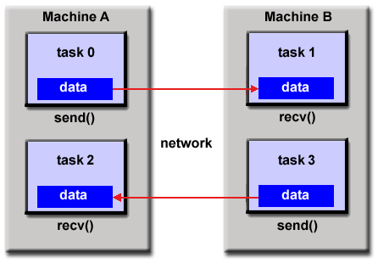
Parallel Programming Models:
Message Passing Model

Slide 17
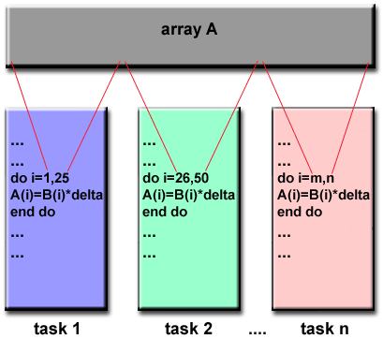
Parallel Programming Models:
Data Parallel Model

Slide 18
Designing Parallel Programs
  Partitioning
  Communication
  Synchronization

Slide 19
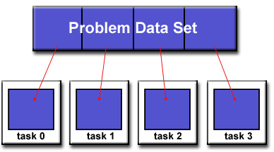
Partition :
Domain Decomposition
Each task handles a portion of the data set.

Slide 20
Designing Parallel Programs
Communication
Synchronous communications are often referred to as blocking communications since other work must wait until the communications have completed.
Asynchronous communications allow tasks to transfer data independently from one another.

Slide 21
Designing Parallel Programs
Synchronization
Types of Synchronization:
Barrier
Lock / semaphore
Synchronous communication operations

Slide 22
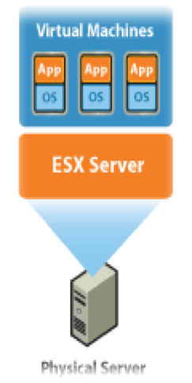
What is Virtualization
With Virtualization it is possible to run multiple operating systems and multiple applications on the same SERVER at the same time, increasing the utilization and flexibility of hardware.

Slide 23
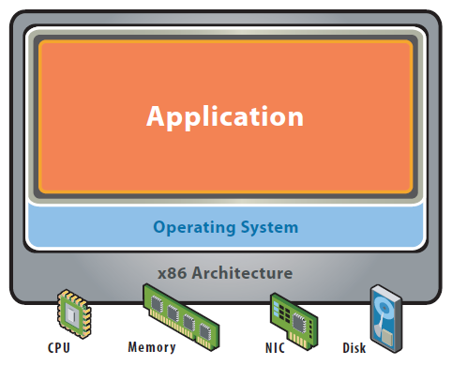
Before Virtualization
Single OS image per machine
Software and hardware tightly coupled
Running multiple applications on same machine often creates conflict
Inflexible and costly infrastructure

Slide 24
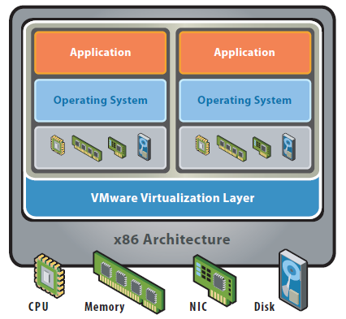
After Virtualization
Hardware-independence of operating system and applications
Virtual machines can be provisioned to any system
Can manage OS and application as a single unit by encapsulating them into virtual Machines

Slide 25
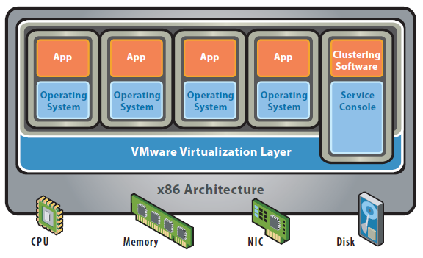
Hypervisor Architecture

Slide 26
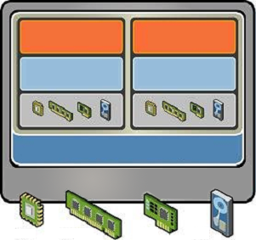
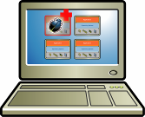
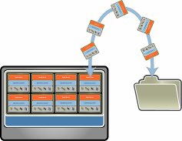
Key features of the virtualization
.Partitioning
  .Different OS can run on one physical machine
  .System resources can be divided between virtual machines
Isolation
  Fault and security isolation on a hardware level
  Extended resource control for constant performance
Encapsulation
  Complete status of a virtual machine can be stored in a file
  Move and copy of a virtual machine is as easy as it is with files

Slide 27
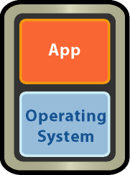

Unplanned Downtime: Server Failure
Simple, Cost effective high availability for all servers
  Automatic restart of virtual machines in case of server failure
  No need for dedicated stand-by hardware
  None of the cost and complexity of clustering
X
Resource Pool

Slide 28
What Is A Distributed System?
A collection of independent computers that appears to its users as a single coherent system.
Features:
  No shared memory – message-based communication
  Each runs its own local OS
  Heterogeneity
Ideal: to present a single-system image:
  The distributed system “looks like” a single computer rather than a collection of separate computers.

Slide 29
Distributed System Characteristics
To present a single-system image:
  Hide internal organization, communication details
  Provide uniform interface
Easily expandable
  Adding new computers is hidden from users
Continuous availability
  Failures in one component can be covered by other components

Slide 30

Distributed System Goals
Resource Accessibility
Distribution Transparency
Openness
Scalability

Slide 31
Discussion
Distributed Systems Vs Cloud

